Slide 1
TOPIC
APPLICATIONS
AREA BY INTEGRATION

Slide 2
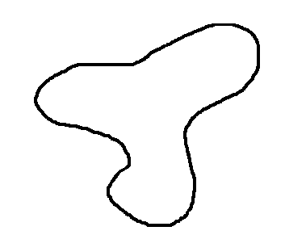
THE AREA UNDER A CURVE
Let us first consider the irregular shape shown opposite.
How can we find the area A of this shape?

Slide 3
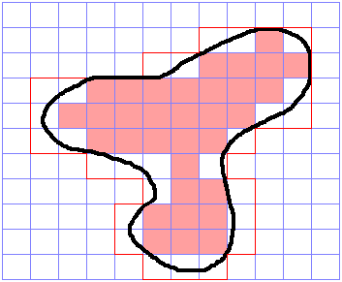
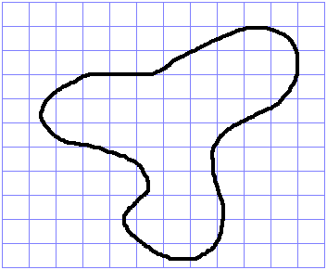
THE AREA UNDER A CURVE
We can find an approximation by placing a grid of squares over it.
By counting squares,
A > 33 and A < 60
i.e. 33 < A < 60

Slide 4
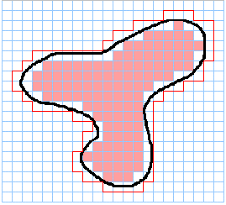
THE AREA UNDER A CURVE
By taking a finer ‘mesh’ of squares we could obtain a better approximation for A.
We now study another way of approximating to A, using rectangles, in which A can be found by a limit process.

Slide 5
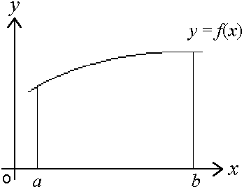
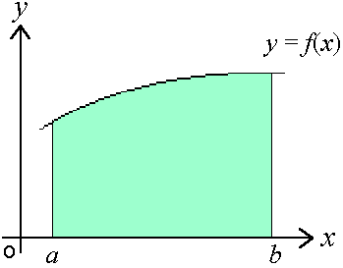
THE AREA UNDER A CURVE
The diagram shows part of the curve y = f(x) from x = a to x = b.
A
We will find an expression for the area A bounded by the curve, the x-axis, and the lines x = a and x = b.

Slide 6
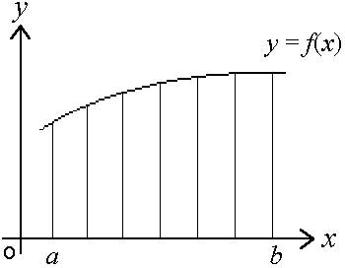
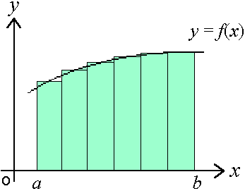
THE AREA UNDER A CURVE
The interval [a,b] is divided into n sections of equal width, Δx.
A
n rectangles are then drawn to approximate the area A under the curve.
Δx

Slide 7

THE AREA UNDER A CURVE
Dashed lines represent the height of each rectangle.
The position of each line is given by an x-coordinate, x_{n}.
The first rectangle has height f(x₁)
f(x₁)
x₁, x₂ , x₃, x₄ , x₅, x₆
Δx₁
and breadth Δx_{1.}
Thus the area of the first rectangle = f(x₁).Δx₁

Slide 8
THE AREA UNDER A CURVE
An approximation for the area under the curve, between x = a to x = b, can be found by summing the areas of the rectangles.
A = f(x₁).Δx₁ + f(x₂).Δx₂ + f(x₃).Δx₃ + f(x₄).Δx₄ + f(x₅).Δx₅ + f(x₆).Δx₆

Slide 9
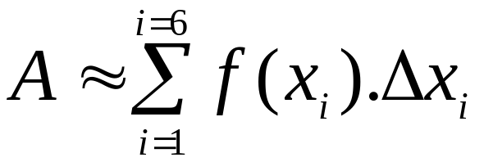
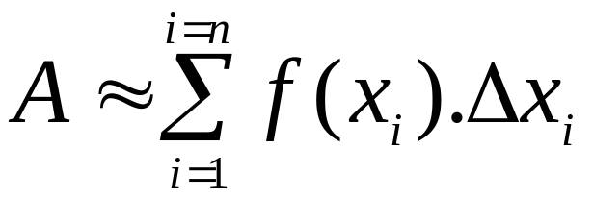
THE AREA UNDER A CURVE
Using the Greek letter Σ (sigma) to denote ‘the sum of’, we have
For any number n rectangles, we then have

Slide 10
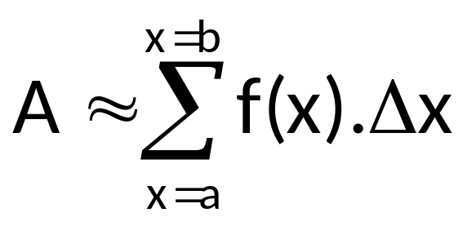
THE AREA UNDER A CURVE
In order to emphasize that the sum extends over the interval [a,b], we often write the sum as

Slide 11
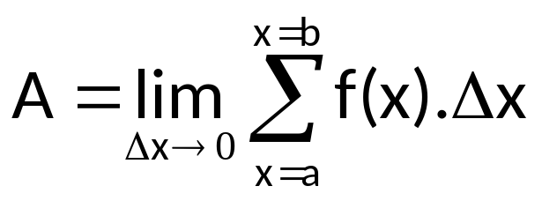
THE AREA UNDER A CURVE
By increasing the number n rectangles, we decrease their breadth Δx.
As Δx gets increasingly smaller we say it ‘tends to zero’,
i.e. Δx → 0.
Remember, we met limits before with Differentiation
So we define

Slide 12

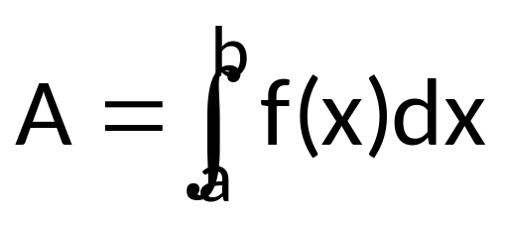
THE AREA UNDER A CURVE
The form
was simplified into the form that we are familiar with today
This reads
‘the area A is equal to the integral of f(x) from a to b’.

Slide 13
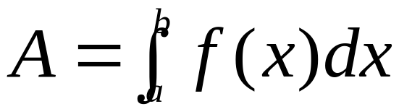

THE AREA UNDER A CURVE
We have derived a method for finding the area under a curve and a formal notation
We have seen the integration symbol before in connection with anti-differentiation, but we have not yet connected finding the area under a curve with the process of integration.

Slide 14
THE AREA UNDER A CURVE
Let us remind ourselves of where we started.
Can we apply this method to calculate the area under a curve?

Slide 15
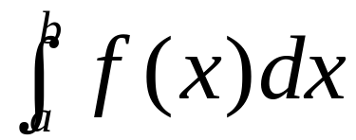
THE AREA UNDER A CURVE
In conclusion,
the area A bounded by the x-axis, the lines x = a and x = b and the curve y = f(x) is denoted by,

Slide 16
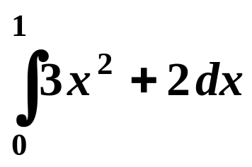
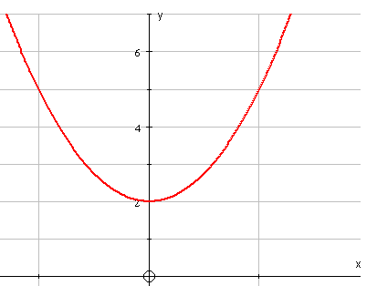

AREAS
Definite integration results in a value.
It can be used to find an area bounded, in part, by a curve
e.g.
gives the area shaded on the graph
The limits of integration . . .
0
1

Slide 17
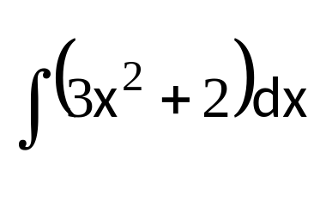
AREAS
Definite integration results in a value.
It can be used to find an area bounded, in part, by a curve
e.g.
1
gives the area shaded on the graph
0
The limits of integration . . .
. . . give the boundaries of the area.
x = 0 is the lower limit
( the left hand boundary )
x = 1 is the upper limit
(the right hand boundary )
0
1

Slide 18
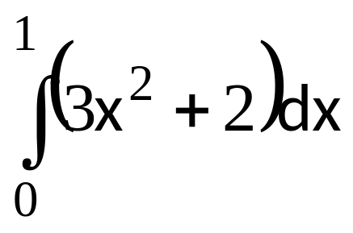
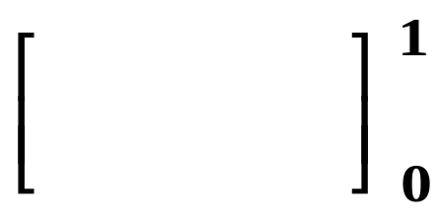
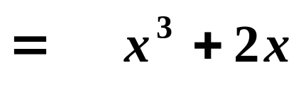

FINDING AN AREA
Since
y
=
3
x
2
+
2
the shaded area equals 3
0
1
The units are usually unknown in this type of question

Slide 19
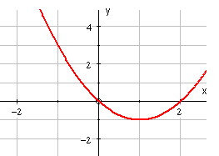
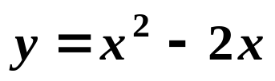
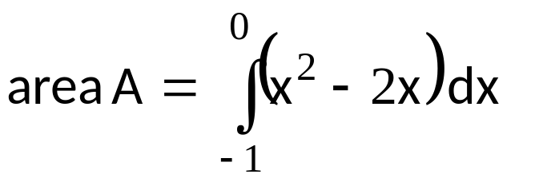
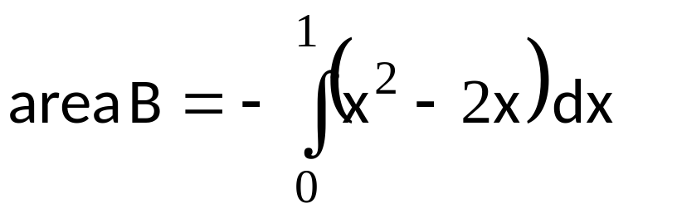
FINDING AN AREA
A
B
For parts of the curve below the x-axis, the definite integral is negative, so

Slide 20
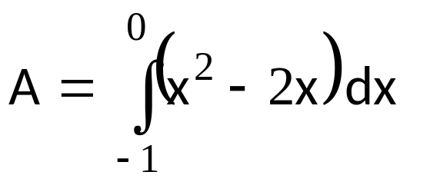
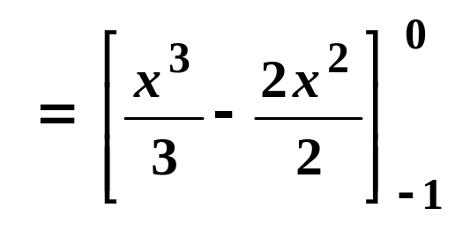

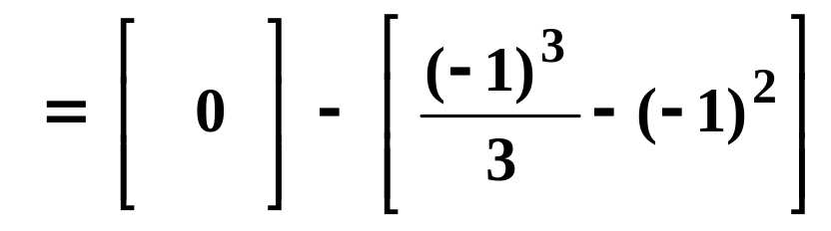
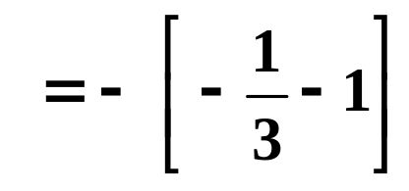
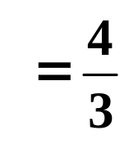

FINDING AN AREA
A
Area A

Slide 21
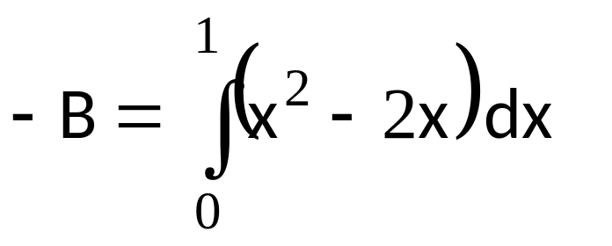
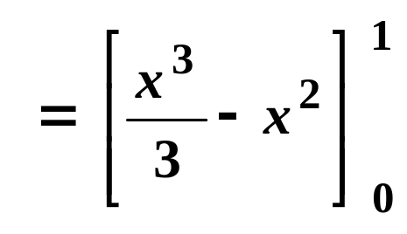
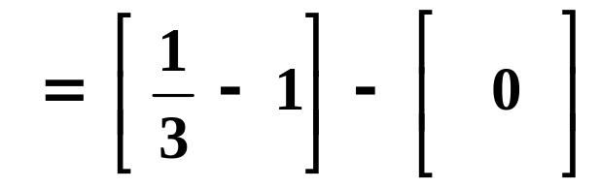
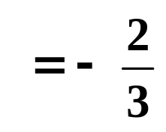
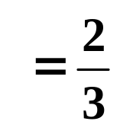
FINDING AN AREA
B
Area B

Slide 22
SUGGESTED STEPS TO DETERMINE THE AREA OF A
PLANE FIGURE BY INTEGRATION:
1.Determine the intersection points of the given boundaries or equations.
2.Graph the given functions.
3.Shade the area to be determined.
4.Consider a thin rectangle anywhere within the region, horizontal or vertical element, to represent the entire region.
5.Determine the dimensions of the rectangular element and limits of integration. Apply the integral using the extreme points as the limit of integration to determine the total area.
6.Set up the area of the element and evaluate the integral throughout the region.

Slide 23
AREA UNDER THE CURVE

Slide 24
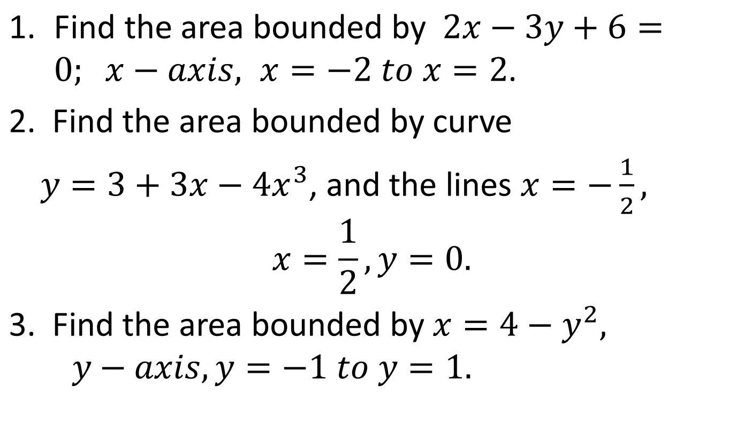
EXAMPLE

Slide 25
AREA BETWEEN TWO CURVES

Slide 26
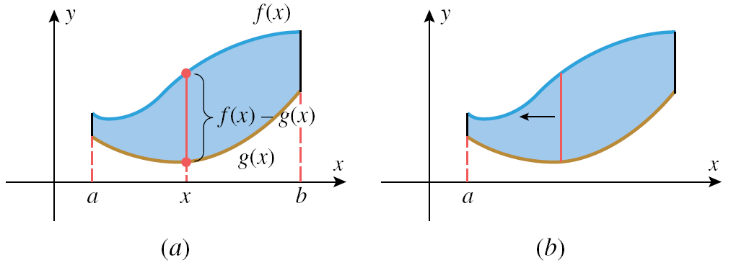
AREA BETWEEN TWO CURVES
Finding the limits of integration for area between two curves
Step 1: Sketch the region and draw a vertical line segment
through the region at the arbitrary point on the x-axis,
connecting the top and bottom boundaries
Step 2. The y-coordinate of the
top endpoint of the line
segment sketched in
step 1 will be f(x), the
bottom one g(x), and
the length of the line
segment will be
f(x) – g(x). This is the
integrand in 1.

Slide 27
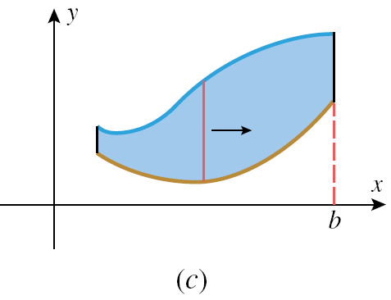
Step 3.
To determine the limits of integration, imagine moving the line segment left and then right. The leftmost position at which the line segment intersects the region is x=a and the rightmost is x=b.

Slide 28
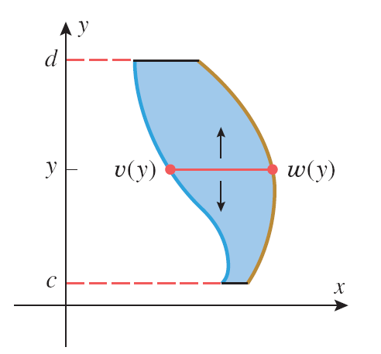
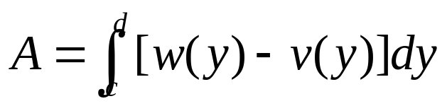

Slide 29
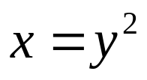

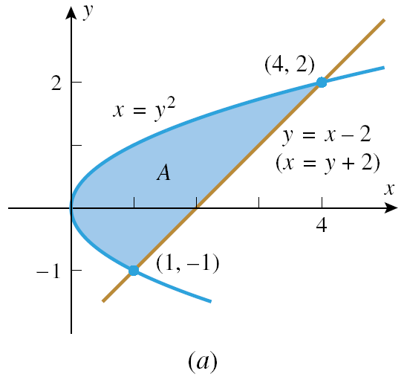
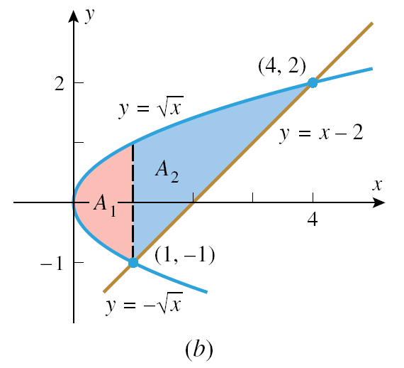
EXAMPLE
Find the area of the region enclosed by and

Slide 30
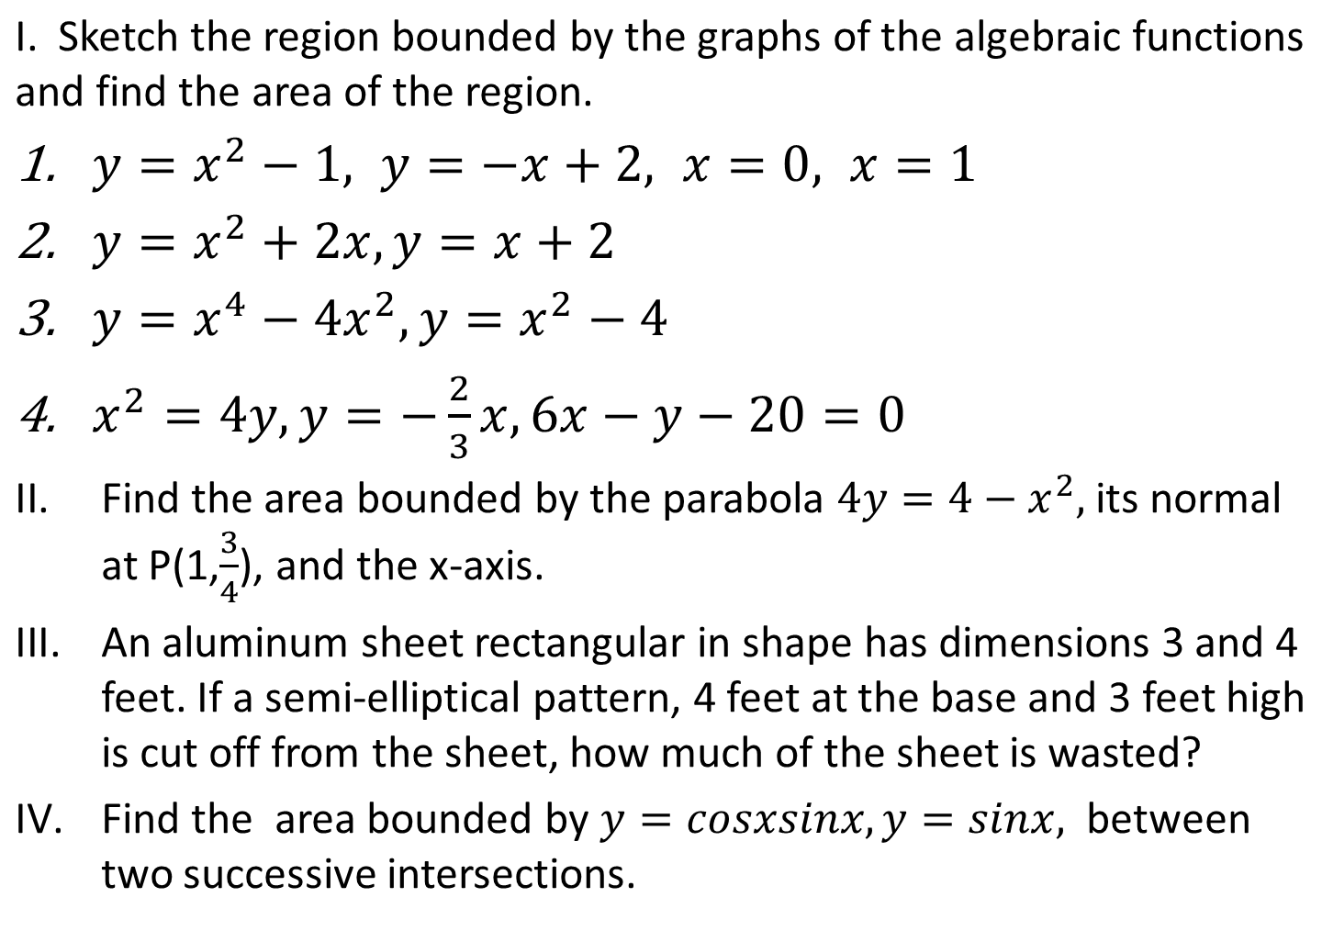
EXERCISES

